Slide 1
Module-2: Supervised Learning:
Regression: Linear regression, Polynomial regression, Model evaluation metrics: MAE, MSE, RMSE.
Classification: Logistic regression, K-Nearest Neighbors (KNN), Decision Trees and Random Forests, Model evaluation metrics: Accuracy, precision, recall, F1-score, ROC-AUC.
Model Training and Evaluation: Train-test split and cross-validation, Hyper parameter tuning using GridSearchCV, Overfitting and underfitting.

Slide 2
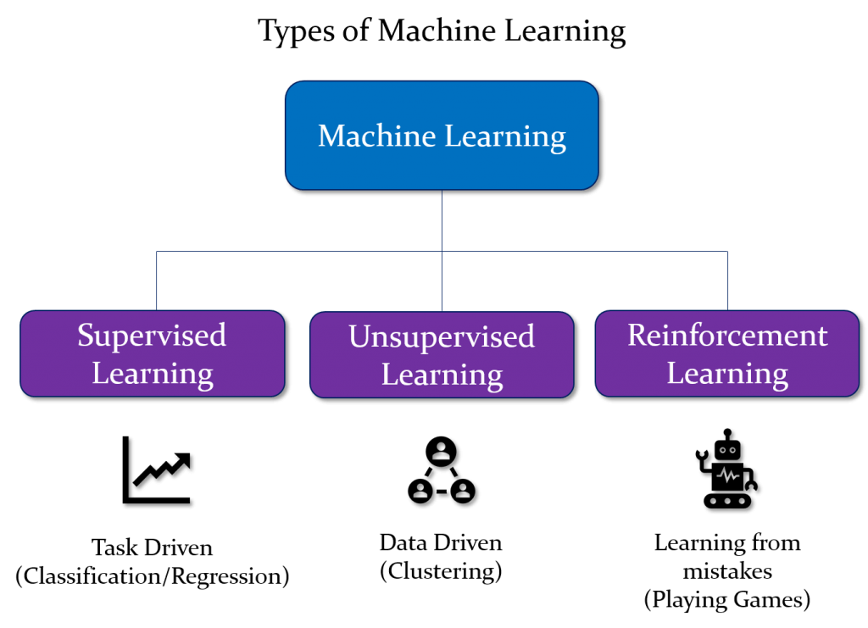

Slide 3
Supervised learning:
Supervised learning is the types of machine learning in which machines are trained using well "labelled" training data, and on basis of that data, machines predict the output. The labelled data means some input data is already tagged or labelled with the correct output.
In supervised learning, the training data provided to the machines work as the supervisor that teaches the machines to predict the output correctly. It applies the same concept as a student learns in the supervision of the teacher. Supervised learning is a process of providing input data as well as correct output data to the machine learning model. The aim of a supervised learning algorithm is to find a mapping function to map the input variable(x) with the output variable(y).
So, the goal of supervised learning is to learn a mapping from inputs to outputs, so that the model can make accurate predictions on new, unseen data.
Note: In supervised learning, models are trained using labelled dataset, where the model learns about each type of data. Once the training process is completed, the model is tested on the basis of test data (a subset of the training set), and then it predicts the output.
https://www.youtube.com/watch?v=olFxW7kdtP8

Slide 4
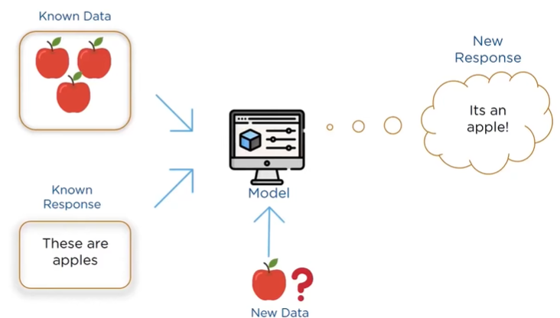

Slide 5
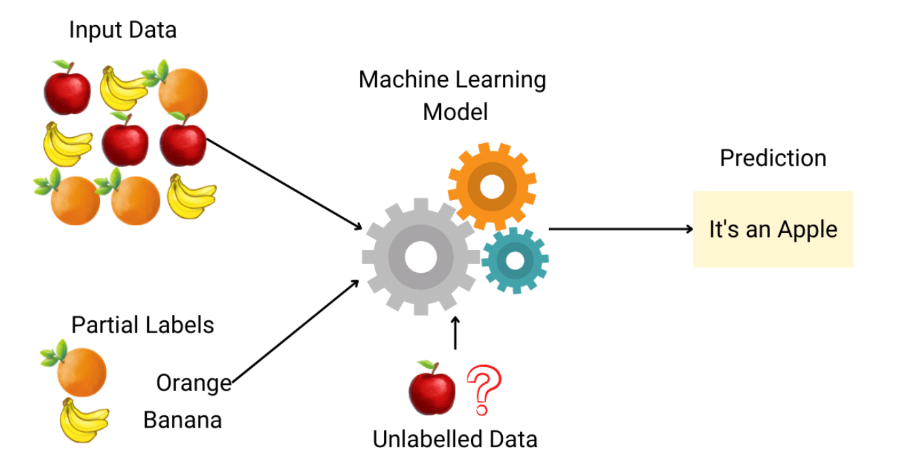

Slide 6
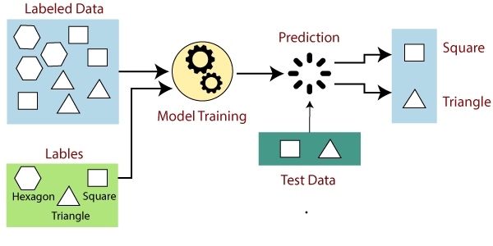

Slide 7
Explanation:
Suppose we have a dataset of different types of shapes which includes square, rectangle, triangle, and Polygon. Now the first step is that we need to train the model for each shape.
If the given shape has four sides, and all the sides are equal, then it will be labelled as a Square.
If the given shape has three sides, then it will be labelled as a triangle.
If the given shape has six equal sides then it will be labelled as hexagon.
Now, after training, we test our model using the test set, and the task of the model is to identify the shape. The machine is already trained on all types of shapes, and when it finds a new shape, it classifies the shape on the bases of a number of sides, and predicts the output

Slide 8
Example-3: Predicting Housing Prices
Let's consider a common example of supervised learning: predicting housing prices based on various features.
Input Features:
Size of the house (in square feet)
Number of bedrooms
Number of bathrooms
Distance to the city center
Presence of nearby amenities (e.g., schools, parks)
Labels (Outputs):
Sale price of the house
Training Dataset:
A dataset containing historical examples of houses with features and their corresponding sale prices.
Model:
A supervised learning algorithm, such as linear regression, is chosen to learn the relationship between the input features and the sale prices.

Slide 9
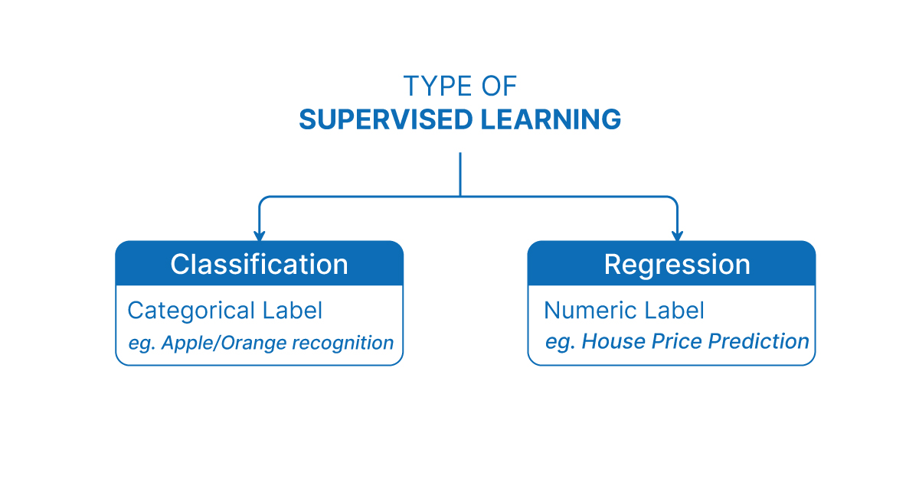

Slide 10
Regression :
Regression is a type of supervised machine learning task where the goal is to predict a continuous numerical value or outcome based on input features.
Regression is a type of supervised machine learning where algorithms learn from the data to predict continuous values such as sales, salary, weight, or temperature.
What mean by continuous numerical value :
In machine learning, the term continuous values refers to numeric values that can take any value within a range, not just fixed or distinct values.
These are real numbers (decimals or integers) that can vary smoothly over a range, as opposed to categorical values, which are fixed labels or classes (like "Yes"/"No", or "Red"/"Green").

Slide 11
Note: In the context of regression in machine learning, a continuous numerical value refers to an outcome or target variable that can take on an infinite number of values within a specific range. In case of predicting a person's age, age is considered a continuous numerical value because it can theoretically take on any value within a certain range (for example, from 0 to 100+ years). There are no gaps or intervals between possible ages, and age can be expressed as a decimal or fraction if necessary (e.g., 25.5 years).
It is a variable that can have any real number value, and there are no distinct categories or classes. The term "continuous" implies that the variable can vary over a continuous range, and there are no gaps or interruptions in the possible values it can take. In contrast, in a classification task, the target variable would be a discrete set of categories or classes.
Note:
Here, “discrete set of categories or classes" refers to a set of distinct and separate values that a variable can take

Slide 12
🔁 Regression Contrast with Classification:
In classification, the outputs are discrete categories, like:
"Pass" or "Fail"
"Spam" or "Not Spam"
"Dog", "Cat", or "Bird"
Whereas in regression, the goal is to predict a number, like:
88.4 marks
₹56,789.25 income

Slide 13
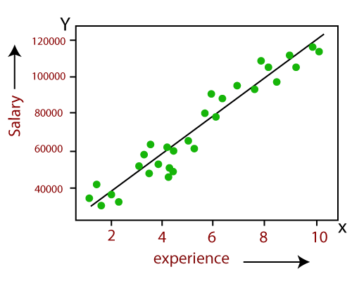
Example:
Linear Regression:
Predicting the salary of an employee on the basis of the year of experience.

Slide 14
Types of Regression:
There are several types of regression techniques, each suited for different kinds of data and relationships between variables.
Linear Regression (Formula: Y = mX + c)
Multiple Linear Regression (Formula: Y = b0 + b1X1 + b2X2 + ... + bnXn)
Polynomial Regression (Formula: Y = b0 + b1X + b2X² + ... + bnXⁿ)
Logistic Regression (Technically Classification)

Slide 15

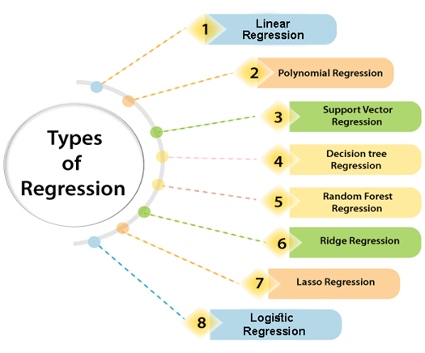

Slide 16
Linear regression:
As the name indicates, simple linear regression is the simplest regression model which involves only one independent variable or predictor and only one Dependent Variable or the Response Variable.
Linear Regression is a supervised learning algorithm used to predict a continuous target variable (Y) based on the value of an independent variable (X), assuming a linear relationship between them.
This model assumes a linear relationship between the dependent variable and the predictor variable i.e, The relationship between Dependent and Independent Variable is Linear. Here Linear means if the value of independent variable increases or decreases then the value of Dependent variable will increase or decreases for sure.

Slide 17
Formula:
Note:
When we are trying to predict a categorical or nominal variable, the problem is known as a classification problem. A classification problem is one where the output variable is a category such as ‘red’ or ‘blue’ or ‘malignant tumour’ or ‘benign tumour’ etc. Whereas when we are trying to predict a numerical variable such as ‘price’, ‘weight’, etc. the problem falls under the category of regression.
Where:
Y = Predicted/Target variable (e.g., Salary)
X = Independent/Input variable (e.g., Years of Experience)
m = Slope (how much Y changes with change in X)
c = Intercept (value of Y when X = 0)
Y = mX + c

Slide 18
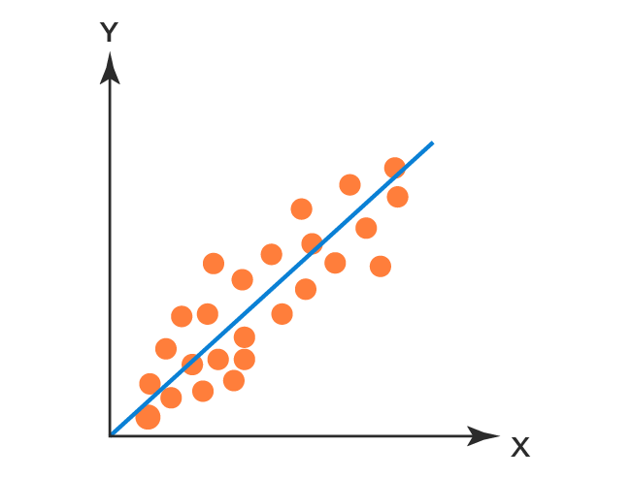
Working of Simple Linear Regression:
The Working of Simple Linear Regression is very Simple that it will draw a straight line in a 2D Plane which is called Best Fit Line.
So our aim is to find the Best Fit Line with minimal Error.
Let’s Take an Example of Height and Weight such that the Problem is to Find a Height of a Person given the Weight.
Note: Best Fit Line is draws based on the Slope of the Line
Best Fit Line
Height
Weight
https://www.youtube.com/watch?v=jerPVDaHbEA

Slide 19
🔢 Example Problem: Predicting Salary
🎯 Goal: Predict the salary of a person based on their years of experience.
🧾 Dataset (Sample):
Here, we want to predict salary for someone with, say, 6 years of experience.
Years of Experience (X) | Salary (Y) in ₹
1 | 3,00,000
2 | 3,50,000
3 | 4,00,000
4 | 4,50,000
5 | 5,00,000

Slide 20
📉 Step-by-Step Process:
Step 1: Visualize Data (Described)
If you plot this data on a graph:
X-axis = Years of Experience
Y-axis = Salary
You will notice a straight-line pattern, which indicates a linear relationship.

Slide 21
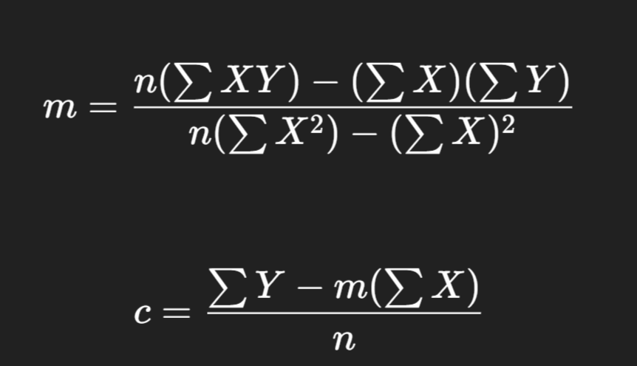
Step 2: Calculate Line of Best Fit
We find values of m (slope) and c (intercept) using a method called least squares, which minimizes the sum of squared differences between actual and predicted salaries.
📌 Slope (m) Formula:
📌 Intercept (c) Formula:

Slide 22
✅ Add Helper Columns — XY and X²
X | Y | X × Y | X²
1 | 300000 | 300000 | 1
2 | 350000 | 700000 | 4
3 | 400000 | 1200000 | 9
4 | 450000 | 1800000 | 16
5 | 500000 | 2500000 | 25

Slide 23
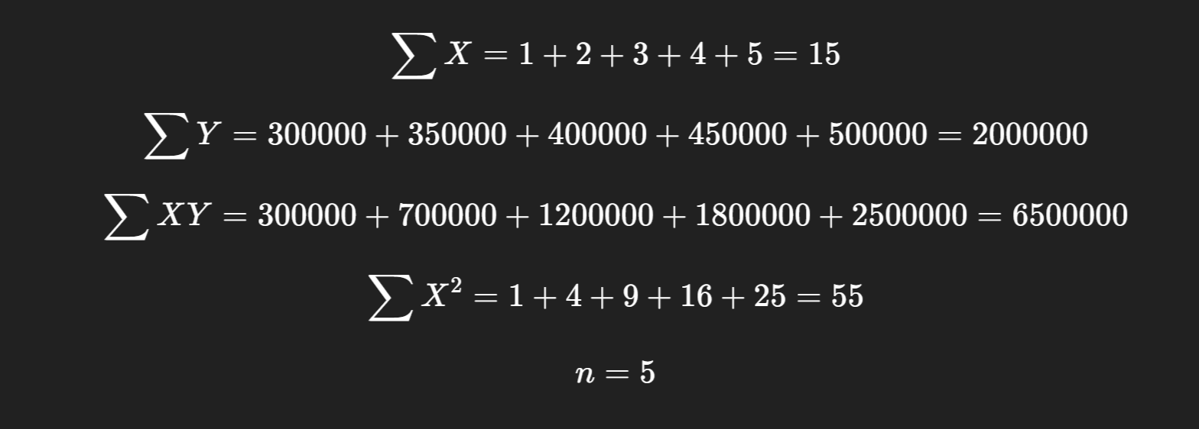
✅ Calculate Summations

Slide 24
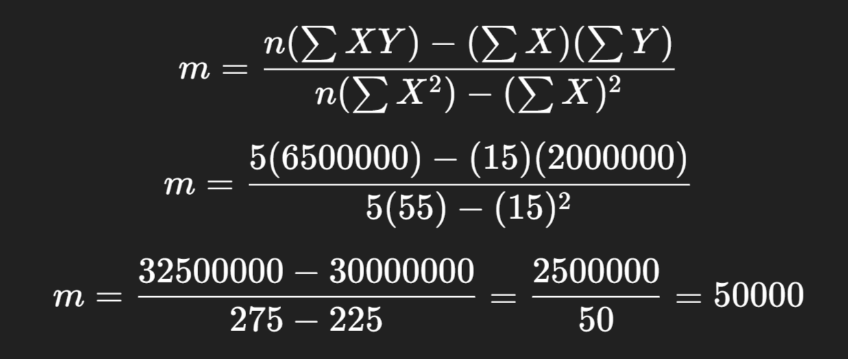
✅ Apply the Slope (m) Formula:

Slide 25
✅ Slope (m) = 50,000
The slope represents how much the salary increases for each additional year of experience.
📘 In Simple Terms:
Every time a person gains 1 more year of experience, their salary increases by ₹50,000 — according to the pattern observed in the dataset.

Slide 26
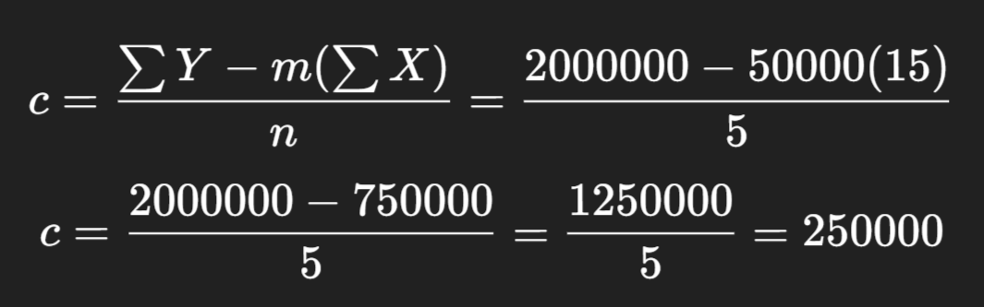
✅ Apply the Intercept (c) Formula

Slide 27
✅ Intercept (c) = ₹2,50,000:
The intercept is the value of Y (salary) when X (years of experience) = 0.
📘 In Simple Words:
Even if a person has 0 years of experience, the model predicts their starting salary will be ₹2,50,000.

Slide 28

✅ Final Linear Regression Equation:

Slide 29
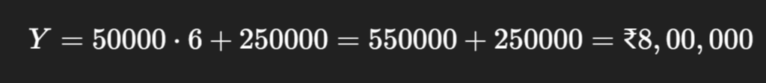
📌 Final Prediction Example:
If a person has 6 years of experience, predicted salary:

Slide 30
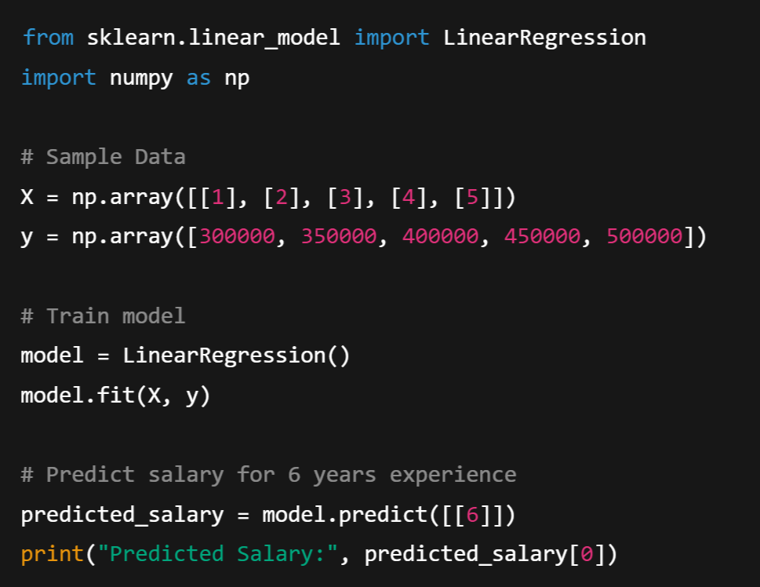
🧪 Python Example
(Using scikit-learn)

Slide 31

Output:

Slide 32
📌 Advantages of Linear Regression
Easy to implement and interpret
Fast to train
Works well with linearly correlated data
Predictive Power
⚠️ Limitations
Assumes linearity or Linear Relationship
Sensitive to outliers
Limited to Numeric, Continuous Data
Doesn’t perform well with non-linear or highly complex relationships

Slide 33
Polynomial Regression:
Polynomial regression model is the extension of the simple linear model.
Polynomial Regression is a type of supervised machine learning algorithm used to predict a continuous dependent variable (Y) based on the value of one or more independent variables (X) — but with a twist:
Unlike Linear Regression, which fits a straight line, Polynomial Regression fits a curved line to the data.

Slide 34
Why Polynomial Regression?
A simple linear regression algorithm only works when the relationship between the data is linear. But suppose we have non-linear data, then linear regression will not be able to draw a best-fit line. Simple regression analysis fails in such conditions. Consider the below diagram, which has a non-linear relationship, and you can see the linear regression results on it, which does not perform well, meaning it does not come close to reality. Hence, we introduce polynomial regression to overcome this problem, which helps identify the curvilinear relationship between independent and dependent variables.
For example:
Salary vs Experience: Salary might grow slowly at first, then rise faster.
Growth of plants: Starts slow, then rapid, then slows again.
Product sales: Might peak and then decline.

Slide 35
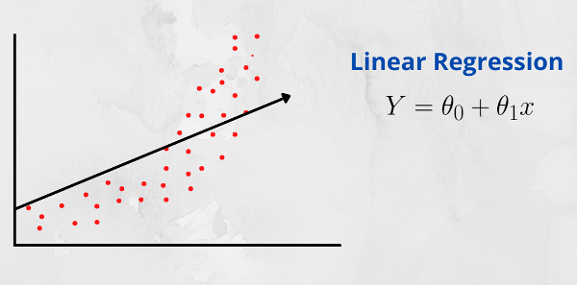
Linear Relationship:
A linear relationship between two variables means that when one variable changes, the other variable changes in a straight-line fashion. In other words, if you were to plot the relationship between the two variables on a graph, the points would form a straight line.
That is, In a linear relationship between two variables, when the value of one variable increases, the value of the other variable also increases if the relationship is positive. Conversely, if the relationship is negative, when the value of one variable increases, the value of the other variable decreases.

Slide 36
Polynomial regression is a form of regression analysis in machine learning (ML) where the relationship between the independent variable X and the dependent variable Y is modeled as an n-degree polynomial. Unlike simple linear regression, which fits a straight line to the data, polynomial regression can capture more complex relationships between variables by introducing polynomial terms.
The general form of a polynomial regression model with one independent variable X can be expressed as:
Polynomial with Degree or Order n:
y = b0 + b1X + b2X² + ....... + bnX^{n} + ε
where:
y is the dependent variable,
x is the independent variable,
b0, b1, b2,…………..bn​ are the coefficients,
n is the l,
ε is the error term.

Slide 37
Polynomial Terms:
Polynomial terms refer to mathematical expressions involving variables raised to powers and multiplied by coefficients. In the context of polynomial regression or polynomial functions, these terms are used to model relationships between variables that are not linear.
A polynomial term typically takes the form bx^{n},
where:
b is a coefficient (a constant multiplier),
x is the variable,
n is a non-negative integer representing the degree of the term (the exponent to which the variable is raised).

Slide 38
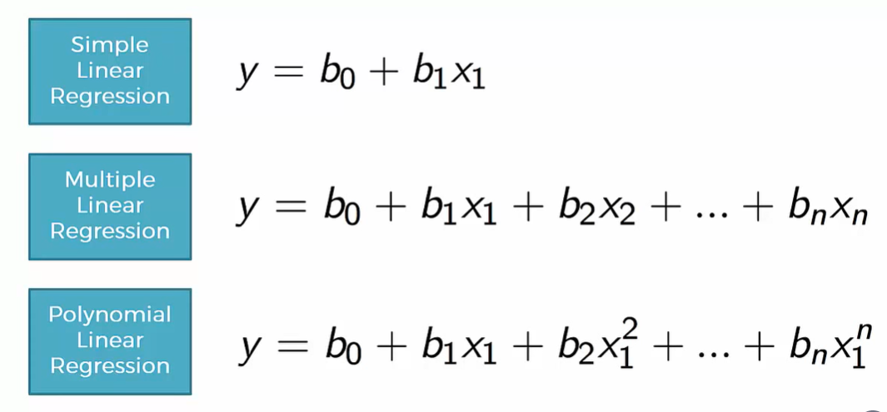

Slide 39
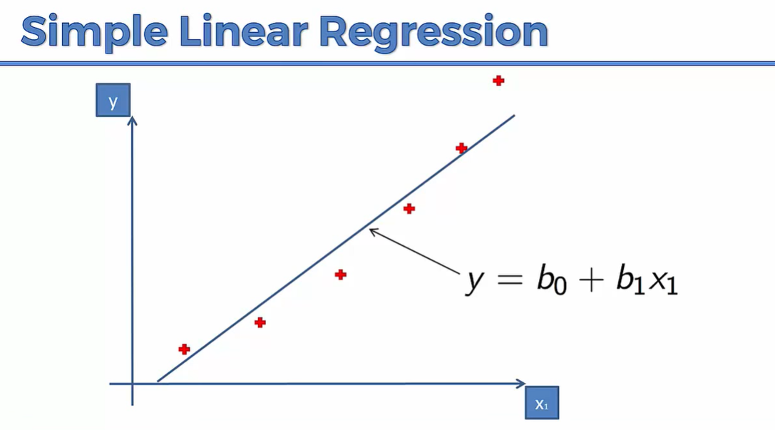

Slide 40
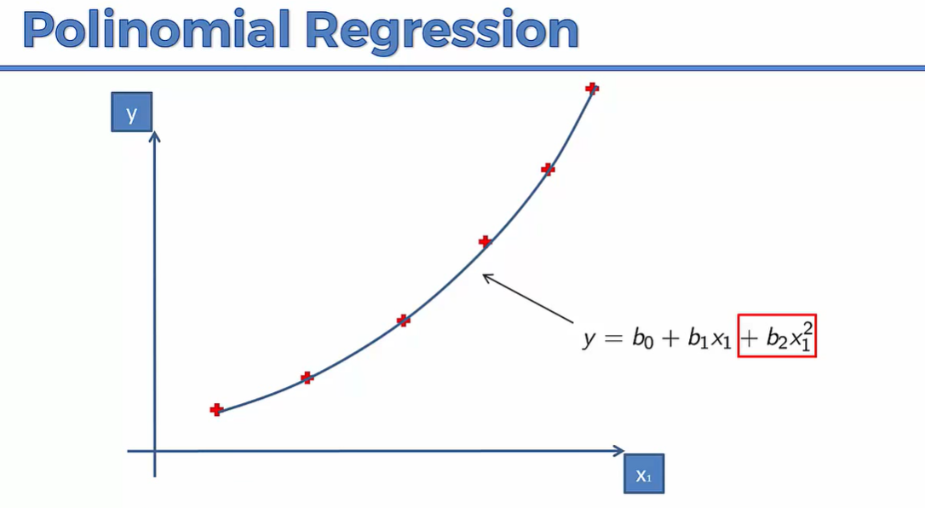

Slide 41
🔢 Example Problem: Predicting Salary
🎯 Goal: Predict the salary of a person based on their years of experience using Polynomial Regression.
🧾 Dataset (Sample):
Here, we want to predict salary for someone with, say, 6 years of experience.
Years of Experience (X) | Salary (Y) in ₹
1 | 3,00,000
2 | 3,50,000
3 | 4,30,000
4 | 5,60,000
5 | 9,00,000

Slide 42
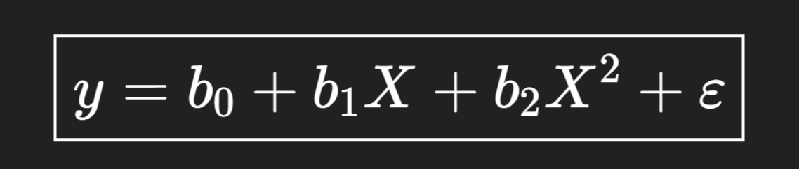
🔍 Observations:
Salary increases slowly at first, then rapidly — this is non-linear growth.
A straight line (linear regression) would not capture this pattern well.
So, we apply polynomial regression with a curve like:
Here, we use a quadratic model (degree 2). You can increase degree (like X³, X⁴...) for more complex curves, but we’ll keep it simple.

Slide 43
✅ Step 1: Compute required columns
X | Y | X² | X³ | X⁴ | XY | X²Y
1 | 300000 | 1 | 1 | 1 | 300000 | 300000
2 | 350000 | 4 | 8 | 16 | 700000 | 1400000
3 | 430000 | 9 | 27 | 81 | 1290000 | 3870000
4 | 560000 | 16 | 64 | 256 | 2240000 | 8960000
5 | 900000 | 25 | 125 | 625 | 4500000 | 22500000

Slide 44
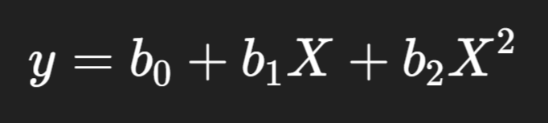
✅ Step 2: Find all totals
∑X=15
∑Y=2540000
∑X2=55
∑X3=225
∑X4=979
∑XY=9030000
∑X2Y=37016000
n=5
We are fitting a quadratic polynomial:

Slide 45
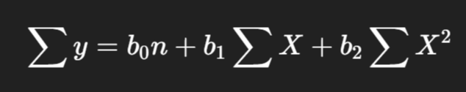
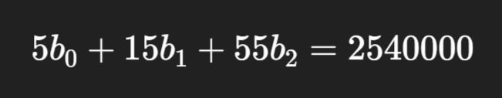
✅ Step 3: Write normal equations:
b0,b1,b2​ are the unknowns (coefficients) we have to find
🧮 Equation 1: Add all the original equations together
We apply summation (∑) on both sides:
This gives the first equation:

Slide 46
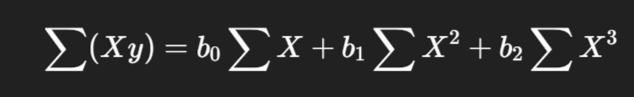
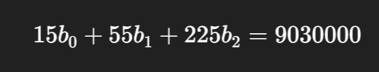
🧮 Equation 2: Multiply each equation by X, then add
We multiply both sides by X and then sum:
This gives:

Slide 47
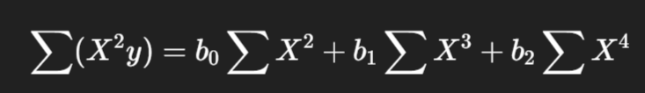

🧮 Equation 3: Multiply each equation by X2, then add
Same idea — multiply both sides by X2, then sum:
Gives:

Slide 48
📌 So why these 3 equations?
Because we’re solving for 3 unknowns:
b0: intercept.
b1: controls slope (linear effect)
b2: controls curve (quadratic effect)
The quadratic effect refers to a specific type of relationship between variables, typically in a mathematical, statistical, or scientific context, where the change in the dependent variable is proportional to the square of the independent variable.
These equations are called the normal equations — and they help the computer find the best-fitting curve behind the scenes.

Slide 49
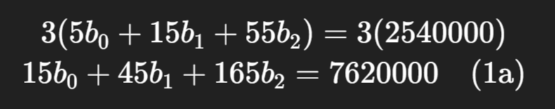
✅ Step 4: Solve the system (simplify the 3 equation):
Eliminate one variable from two equations:
Let’s eliminate b₀ from (1) and (2).
Multiply equation (1) by 3:

Slide 50
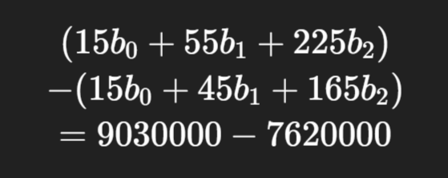
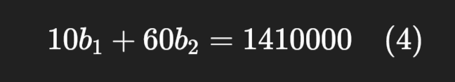
Now subtract (1a) from (2):
Gives:

Slide 51
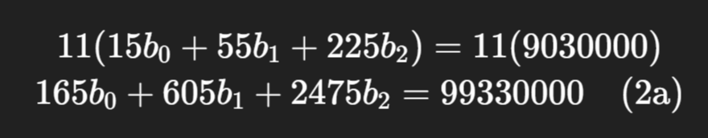
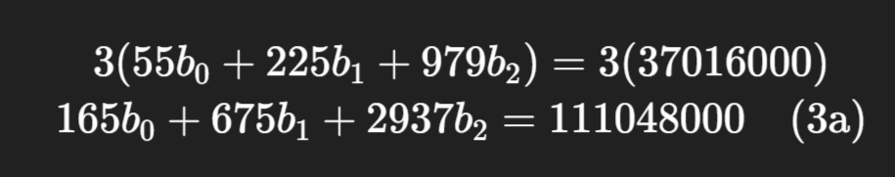
2. Eliminate b₀ from (2) and (3):
Multiply equation (2) by 11:
Multiply equation (3) by 3:

Slide 52
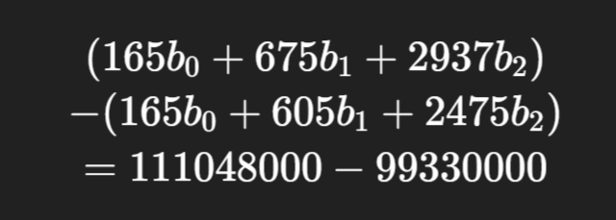
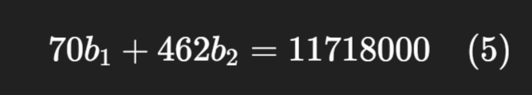
Now subtract (2a) from (3a):
Gives:

Slide 53



3. Solve equations (4) and (5):
Equation (4):
Equation (5):
Let’s multiply (4) by 7:

Slide 54

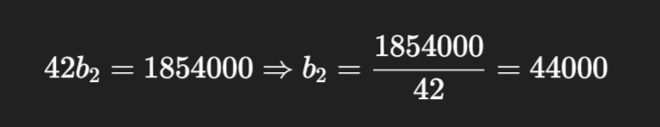
Now subtract (4a) from (5):
Gives:

Slide 55
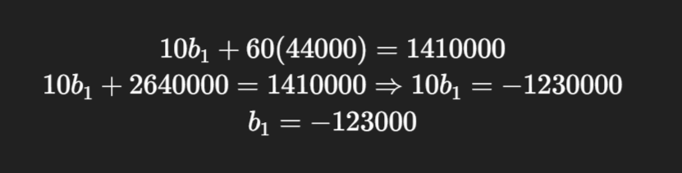
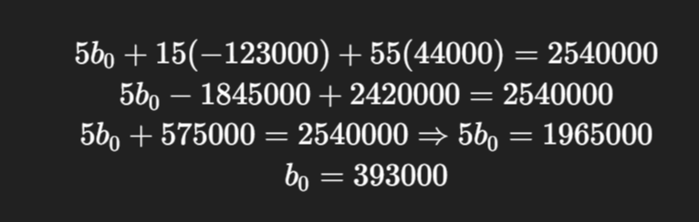
4. Back-substitute to find b₁:
5. Back-substitute to find b₀:

Slide 56
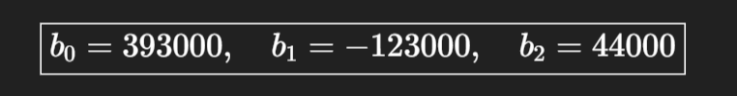

🎉 Final Answer:
✅ Final Equation:

Slide 57
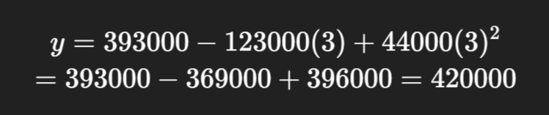
Test the Solution:
For X = 3:
👉 Close to actual value ₹4,30,000

Slide 58
Model evaluation metrics:
MAE (Mean Absolute Error)
MSE (Mean Squared Error)
RMSE (Root Mean Squared Error)
These are commonly used to evaluate regression models, where the goal is to predict continuous values (e.g., predicting house prices, temperatures, etc.).

Slide 59
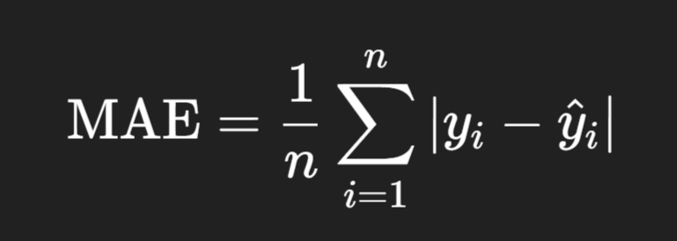
MAE – Mean Absolute Error:
Definition: It is the average of the absolute differences between predicted and actual values.
yi = actual value
𝑦^𝑖 = predicted value
n = total number of predictions
🟢 Interpretable in the same unit as the target variable.
Absolute: Ignoring the sign of a number — whether it's positive or negative — and just taking the magnitude (size).

Slide 60
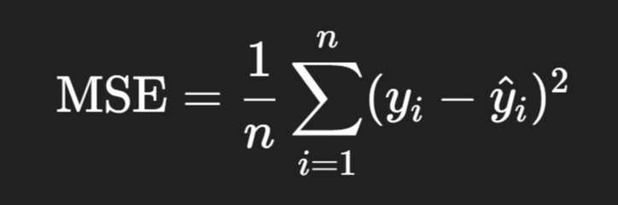
2. MSE – Mean Squared Error:
Definition: It is the average of the squared differences between predicted and actual values.
Penalizes large errors more than MAE due to squaring.
When we say a metric penalizes large errors, it means:
The metric gives more "weight" to big errors compared to small ones.
So, a bigger mistake affects the metric more strongly—especially in MSE and RMSE, because they square the error.

Slide 61
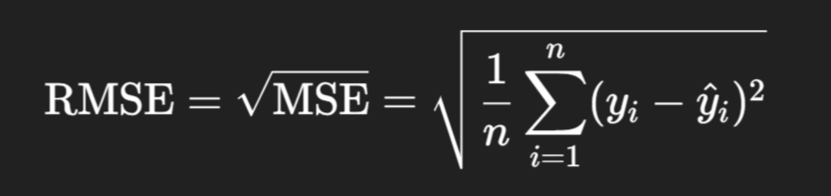
3. RMSE – Root Mean Squared Error:
Definition: It is the square root of the MSE.
Same unit as target variable.
Sensitive to large errors (like MSE), but more interpretable.

Slide 62
Example:
Suppose you have a regression model predicting house prices. You test it on 4 houses.
House | Actual Price (y) | Predicted Price (ŷ)
1 | 100 | 110
2 | 200 | 190
3 | 300 | 310
4 | 400 | 390

Slide 63
➤ Step 1: Calculate Errors
House | Error = y - ŷ | |Absolute Error| | Squared Error
1 | 100 - 110 = -10 | 10 | 100
2 | 200 -190 = 10 | 10 | 100
3 | 300 - 310 = -10 | 10 | 100
4 | 400 - 390 = 10 | 10 | 100

Slide 64
➤ Step 2: Calculate Metrics:
MAE = (10 + 10 + 10 + 10) / 4 = 10
MSE = (100 + 100 + 100 + 100) / 4 = 100
RMSE = √100 = 10
➤ Step 2: Conclusion:
Each predicted price is about ₹10 higher or lower than the actual price — on average.
That 10 tells you how "far off" your predictions are — on average.
Smaller the number → better your model.

Slide 65
🧠 Which one to use?
Use MAE when all errors should contribute equally.
Use MSE or RMSE when large errors should be penalized more.
RMSE is often preferred in practice due to being in the same unit as the original variable.

Slide 66
2. Classification:
Classification is a type of supervised machine learning task where the goal is to predict the category or class that a new instance or observation belongs to, on the basis of training data. The output variable in classification is discrete and represents different classes or labels.
In Classification, a program learns from the given dataset or observations and then classifies new observation into a number of classes or groups. Such as, Yes or No, 0 or 1, Spam or Not Spam, cat or dog, etc. Classes can be called as targets/labels or categories.
Unlike regression, the output variable of Classification is a category, not a value, such as "Green or Blue", "fruit or animal", etc. Since the Classification algorithm is a Supervised learning technique, hence it takes labeled input data, which means it contains input with the corresponding output. The best example of an ML classification algorithm is Email Spam Detector.
The main goal of the Classification algorithm is to identify the category of a given dataset, and these algorithms are mainly used to predict the output for the categorical data.

Slide 67
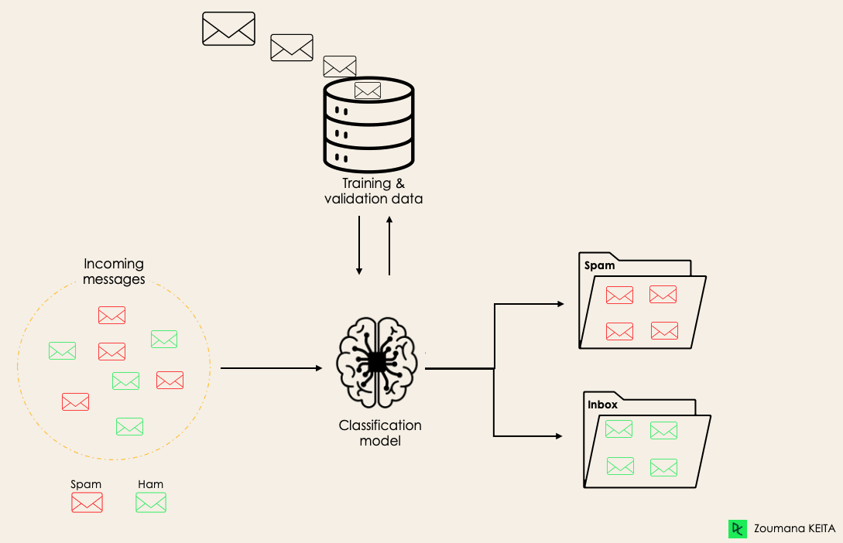
Spam Detection

Slide 68
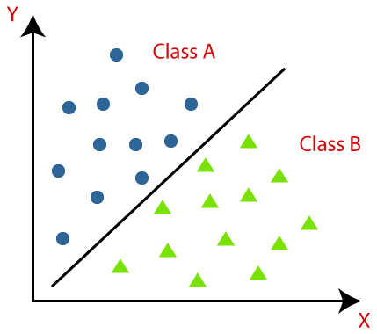
Example-2:
Classification algorithms can be better understood using the below diagram. In the below diagram, there are two classes, class A and Class B. These classes have features that are similar to each other and dissimilar to other classes.
The algorithm which implements the classification on a dataset is known as a classifier.
There are two types of Classifications:
Binary Classification
Multi-class Classifier

Slide 69
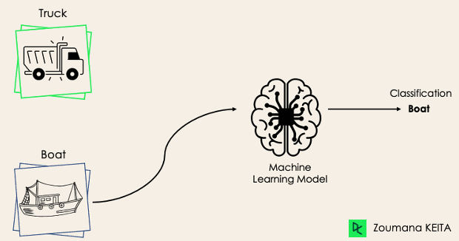
Binary Classification
In a binary classification task, the goal is to classify the input data into two mutually exclusive categories. The training data in such a situation is labeled in a binary format: true and false; positive and negative; O and 1; spam and not spam, male or female etc. depending on the problem being tackled.
For instance, we might want to detect whether a given image is a truck or a boat.
In Binary classification task, “Mutually Exclusive" means that the two categories or classes into which the input data is classified are distinct and cannot occur simultaneously for a single instance of input data.
An email cannot be both "spam" and "not spam" at the same time.
Note: If the classification problem has only two possible outcomes, then it is called as Binary Classifier.

Slide 70
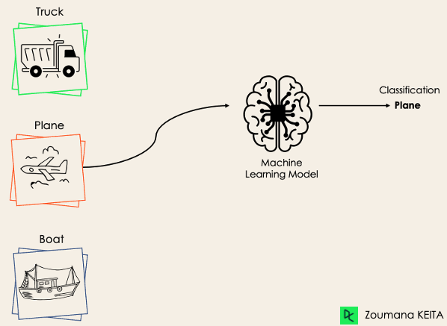
If a classification problem has more than two outcomes, then it is called as Multi-class Classifier.
Example: Classifications of types of crops, Classification of types of music.
Multi-Class Classification:
The multi-class classification, on the other hand, has at least two mutually exclusive class labels, where the goal is to predict to which class a given input example belongs to. In the following case, the model correctly classified the image to be a plane.

Slide 71
Classification Algorithms:
The most common classification algorithms used are
Logistic Regression
K-Nearest Neighbor (kNN)
Decision tree
Random forest
Support Vector Machine (SVM)

Slide 72
Logistic Regression:
Logistic regression is a versatile technique that serves both classification and regression tasks, depending on the context in which it is applied. It's primarily utilized as a classification method and is often referred to as logit regression.
This statistical approach is employed for predicting the outcome of a categorical dependent variable. In logistic regression, the dependent variable (Y) typically takes on binary values (0 or 1), representing two possible outcomes. Meanwhile, the independent variables (X) are continuous in nature, providing predictive features for the model.
Logistic regression is used when our dependent variable is dichotomous or binary. It just means a variable that has only 2 outputs, for example, A person will survive this accident or not, The student will pass this exam or not. The outcome can either be yes or no (2 outputs). This regression technique is similar to linear regression and can be used to predict the Probabilities for classification problems. Like all regression analyses, logistic regression is a predictive analysis.

Slide 73
Logistic regression:
Despite its name, logistic regression is used for classification, not regression.
✅ It predicts the probability that an input belongs to a particular class (like Yes/No, Spam/Not Spam, Pass/Fail, etc.).
🔍 When to use Logistic Regression?
You use it when:
The target variable is categorical (e.g., 0 or 1).
You want to predict probabilities and class labels.

Slide 74
Here's how logistic regression works:
Binary Classification Task: Logistic regression is primarily used for binary classification, where the target variable y has only two possible outcomes (e.g., 0 or 1, "Yes" or "No", "True" or "False").
Sigmoid Function: Logistic regression applies the logistic function also called the sigmoid function to transform the output of a linear equation into a value between 0 and 1.
Logistic Regression is similar to Linear Regression Except Logistic Regression predicts whether something is 0 or 1 i.e, True or False, Instead of predicting something continuous like size, house price, salary etc.
The logistic regression model works by transforming the Linear Regression equation using a Logistric Function, which maps any value between -∞ to +∞ to a range between 0 and 1. The logistic function used in Logistic Regression is called as Sigmoid and it's equation is as follows.
https://www.youtube.com/watch?v=yIYKR4sgzI8&t=13s

Slide 75
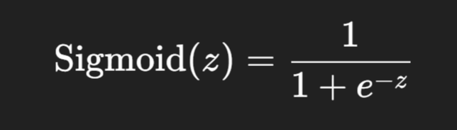
What is the Sigmoid Function?
The sigmoid function is a mathematical function that maps any real number (from −∞ to +∞) to a value between 0 and 1.
It looks like an S-shaped curve (also called a "logistic curve").
Formula:
Where:
z is any real number (could be output of a linear function)
e is Euler’s number (~2.718)
The result is always a value between 0 and 1

Slide 76
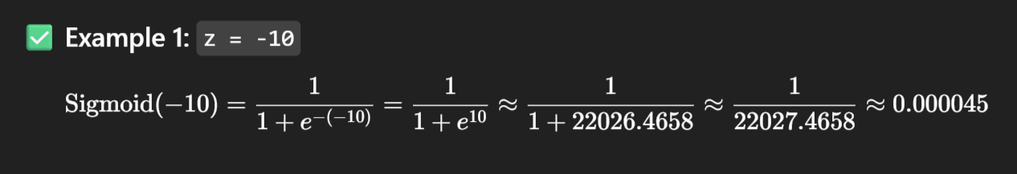
🔍 How it works (some values):
Input (z) | Sigmoid(z) = 1/ 1 + e^-z
-10 | ~0.000045
-2 | ~0.12
0 | 0.5
2 | ~0.88
10 | ~0.99995

Slide 77
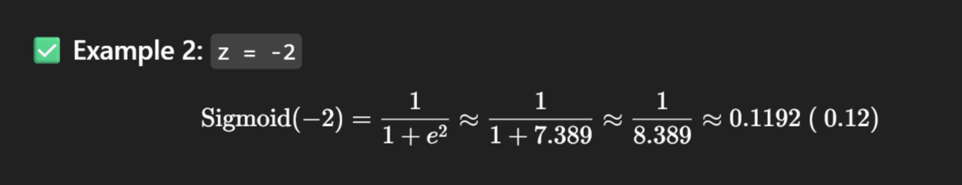
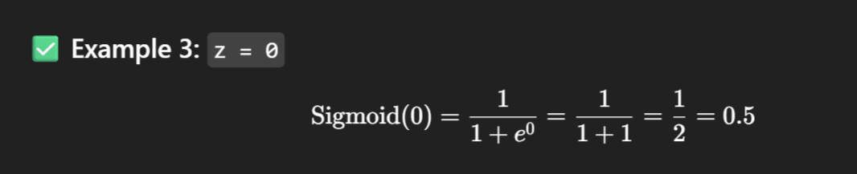
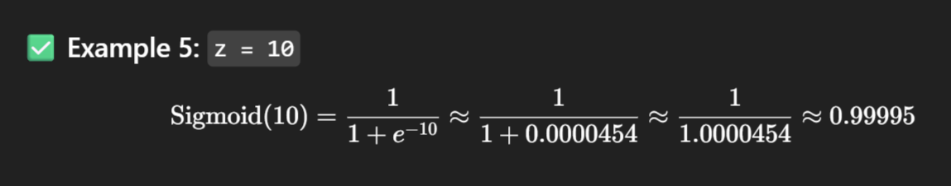

Slide 78

Instead of fitting a line to the data, logistic regression fits an "S" shaped "Logistic Function" or "Sigmoid Function".
Best Fit Line
Height
Weight

Slide 79
🎯 Real-Life Example: Predicting if a Student Will Pass:
Let’s say you want to predict whether a student will pass (1) or fail (0) an exam based on the hours they study.
Hours Studied (X) | Result (Y)
1 | 0 (Fail)
2 | 0 (Fail)
3 | 0 (Fail)
4 | 1 (Pass)
5 | 1 (Pass)
6 | 1 (Pass)
We want a model to predict Y = 0 or 1 based on X.

Slide 80

❌ Why not use Linear Regression?
In Linear Regression, we might model it like:
But this can give values like 1.5 or -0.3, which are not valid as class predictions (you can't get "1.5 Pass").
Also, the values are not restricted between 0 and 1, but probabilities must be!
✅ Logistic Regression Fixes This
Logistic Regression applies a sigmoid function to squash outputs to be between 0 and 1.

Slide 81

✅ Step 1: Linear Function:
We start by computing a linear combination:
This z can range from −∞ to +∞
Why do we start from a linear equation in logistic regression?
Logistic regression is based on linear regression, but it's used for classification, not regression. So, it keeps the linear combination part and adds a twist to map it into probabilities.

Slide 82

✅ Step 2: Apply Sigmoid Function:
Now, convert z to a probability using the sigmoid:
This gives a probability between 0 and 1.
✅ Step 3: Classification
We now set a threshold, typically 0.5:
If probability ≥ 0.5 → predict 1 (Pass)
If probability < 0.5 → predict 0 (Fail)

Slide 83


✅ Step 4: Suppose the trained model gives: β0 =−5, β1=1.5
✅ Step 5: Make Predictions:
Let’s plug in x = 3 (3 hours studied):
That means: 38% chance of passing
Since 0.38 < 0.5 → Model predicts Fail (0)

Slide 84
✅ Advantages of Logistic Regression
Simple and fast
Works well for linearly separable data
Gives probabilities, not just labels
Easy to interpret
❌ Limitations
Assumes a linear boundary between classes
Not suitable for complex, non-linear patterns (use Decision Trees, SVM, Neural Networks for that)

Slide 85
K-Nearest Neighbors (KNN)

Slide 86
k-Nearest Neighbour (kNN)
The kNN algorithm is a simple but extremely powerful Classification and Regression algorithm. The name of the algorithm originates from the underlying philosophy of KNN —i.e. people having similar background or mindset tend to stay close to each other. In other words, neighbors in a locality have a similar background.
In the same way, as a part of the KNN algorithm, the unknown and unlabelled data which comes for a prediction problem is judged on the basis of the training data set elements which are similar to the unknown element. So, the class label of the unknown element is assigned on the basis of the class labels of the similar training data set elements.
The k-nearest neighbors (KNN) algorithm is often referred to as a “LAZY" learning algorithm because it does not involve a training phase where the model learns explicit patterns from the training data. Instead, during the training phase, KNN simply memorizes the entire training dataset. This means that the model does not attempt to generalize or build a compact representation of the data.
Hyper Parameter (K) - Hyperparameters are parameters whose values are set before the learning process begins.

Slide 87

Working Of KNN Algorithm
Feature
K = 5
Feature
Note: The value of the K must be Odd number

Slide 88
Algorithm:
Step 1 − For implementing any algorithm, we need dataset. So, in the first step of KNN, we
must load the training as well as test data.
Step 2 − Next, we need to choose the value of K (Initialize the K) i.e. the nearest data points. K can be any integer. K is a Hyper Parameter.
Step 3 − For each point in the test data do the following
3.1 − Calculate the distance between test data and each row of training data with the help of Euclidean distance.
3.2 − Now, based on the distance value, sort them in ascending order.
3.3 − Next, it will choose the top K rows from the sorted array. i.e First K entries from the array.
3.4 − Now, it will assign a class to the test point based on most frequent class of these
rows.
3.5 − If it is a Regression problem then return the Mean of the K labels.
3.6 − If it is a Classification Problem ten return the Mode of the K labels.
Step 4 − End

Slide 89

Euclidean Distance:
We mostly use this distance measurement technique to find the distance between consecutive points. It is generally used to find the distance between two real-valued vectors. Euclidean distance is used when we have to calculate the distance of real values like integer, float, etc… One issue with this distance measurement technique is that we have to normalize or standard the data into a balance scale otherwise the outcome will not preferable.
Let’s take an example of a 2-Dimensional vector and take a geometrical intuition of distance measures on 2-Dim data for a better understanding.
The Euclidean distance between two points A and B in n-dimensional space is calculated using the formula:
Where:
A=(a1​,a2​,…,an​) and B=(b1​,b2​,…,bn​) are the coordinates of the two points in n-dimensional space.
ai​ and bi​ are the ith coordinates of points A and B, respectively.

Slide 90


Slide 91

Example-2

Slide 92


Slide 93

Note: This is the generalized formula for Euclidean or Manhattan Distance in m-dimensional space

Slide 94


Slide 95


Slide 96


Slide 97
Decision Tree:
Decision tree learning is one of the most widely adopted algorithms for classification. As the name indicates, it builds a model in the form of a tree structure.
It has a hierarchical tree structure consisting of a root node, branches, internal nodes, and leaf nodes. Decision trees are used for classification and regression tasks, providing easy-to-understand models.
Its grouping exactness is focused with different strategies, and it is exceptionally productive. A decision tree is used for multi-dimensional analysis with multiple classes. It is characterized by fast execution time and ease in the interpretation of the rules.

Slide 98
Properties of Decision Tree:
The goal of decision tree learning is to create a model based on the past data called past vector that predicts the value of the output variable based on the input variables in the feature vector.
Each node (or decision node) of a decision tree corresponds to one of the feature vector.
From every node, there are edges to children, wherein there is an edge for each of the possible values (or range of values) of the feature associated with the node.
The tree terminates at different leaf nodes (or terminal nodes) where each leaf node represents a possible value for the output variable.
The output variable is determined by following a path that starts at the root and is guided by the values of the input variables.

Slide 99
Algorithm for decision tree
Step-1: Begin the tree with the root node, says S, which contains the complete dataset.
Step-2: Find the best attribute in the dataset using Attribute Selection Measure (ASM).
Step-3: Divide the S into subsets that contains possible values for the best attributes.
Step-4: Generate the decision tree node, which contains the best attribute.
Step-5: Recursively make new decision trees using the subsets of the dataset created in
step -6: Continue this process until a stage is reached where you cannot further classify the nodes and called the final node as a leaf node.

Slide 100

A Decision tree is usually represented in the format given Below

Slide 101
Building a decision tree:
Decision trees are built corresponding to the training data following an approach called recursive partitioning. The approach splits the data into multiple subsets on the basis of the feature values. It starts from the root node, which is nothing but the entire data set. It first selects the feature which predicts the target class in the strongest way. The decision tree splits the data set into multiple partitions, with data in each partition having a distinct value for the feature based on which the partitioning has happened. This is the first set of branches. Likewise, the algorithm continues splitting the nodes on the basis of the feature which helps in the best partition. This continues till a stopping criterion is reached.
The usual stopping criteria are:
1. All or most of the examples at a particular node have the same class
2. All features have been used up in the partitioning
3. The tree has grown to a pre-defined threshold limit

Slide 102


Slide 103

Example of Decision Tree:
Decision trees are upside down which means the root is at the top and then this root is split into various several nodes. Decision trees are nothing but a bunch of if-else statements in layman terms. It checks if the condition is true and if it is then it goes to the next node attached to that decision.

Slide 104

In the below diagram the tree will first ask what is the weather? Is it sunny, cloudy, or rainy? If yes then it will go to the next feature which is humidity and wind. It will again check if there is a strong wind or weak, if it’s a weak wind and it’s rainy then the person may go and play.
Note: All the Non-Leaf Nodes are Features

Slide 105
Example: Build a decision tree using the give data:
Choosing the root node: We start by selecting the feature that best splits the data. We can use metrics like Gini impurity or information gain to measure the effectiveness of each feature. In this case, let's choose "Can fly" as the root node because it best separates birds from mammals.
2. Splitting the data: We partition the dataset based on the values of the selected feature. For "Can fly," we have two branches: "Yes" and "No."
3. Repeat: We repeat the process for each branch, selecting the best feature to split the data until we reach a stopping criterion (e.g., maximum depth, minimum number of samples per leaf).
Animal | Has fur (Hair) | Has feathers | Lays eggs | Can fly | Type
Dog | Yes | No | No | No | Mammal
Eagle | No | Yes | No | Yes | Bird
Platypus | Yes | No | Yes | No | Mammal
Sparrow | No | Yes | No | Yes | Bird
Bat | Yes | No | No | Yes | Mammal
Ostrich | No | Yes | Yes | No | Bird

Slide 106
Can fly?
Yes
No
Bird
Has fur?
Yes
No
Mammal
Has feathers?
Yes
No
Bird
Mammal

Slide 107
Challenges in implementing the decision tree
Overfitting:
Decision trees can get too specific to the training data, capturing noise instead of true patterns. Imagine trying to memorize all answers to a quiz, including the wrong ones, instead of understanding the concepts.
Overfitting occurs when a machine learning model learns the training data too well, but fails to generalize to new, unseen data.
2. Choosing the Right Questions (Features):
Deciding which question to ask at each step (like "Can it fly?") can be tricky. If we ask the wrong questions, we won't get closer to the correct answer. It's like playing a guessing game where some questions are more useful than others.
3. Handling Continuous Information:
Decision trees prefer categorical (yes/no) questions, so dealing with continuous information, like temperature, requires converting it into categories (hot, cold, warm).
4. Data Imbalance: If there are far more examples of one class than another, the tree might favor the majority class, ignoring the minority. It's like a classroom where the teacher only pays attention to the rowdy students, neglecting the quiet ones.

Slide 108
5. Complexity and Time:
Building a decision tree can take a lot of time, especially if there are many features or a large dataset. It's like drawing a very intricate map – the more details you include, the longer it takes to finish.
6. Making Sense of the Tree: While decision trees are easy to understand visually, complex trees can become like tangled branches, making it hard to see the overall structure. It's like trying to navigate a forest with too many trees blocking your view.
7. Handling Missing Information: Decision trees don't handle missing data well. If some information is missing, it's like trying to answer a question without all the necessary clues.
8. Balancing Simplicity and Accuracy: Sometimes, simpler trees are better because they generalize well to new data. Finding the right balance between a simple and accurate tree is like finding the perfect recipe – not too complicated, but not missing any key ingredients.

Slide 109

Random Forest:
Random forest is an ensemble classifier, i.e. a combining classifier that uses and combines many decision tree classifiers. It is also used for Regression.
Random Forest combines the output of multiple decision trees to reach a single result. It combines the opinions of many “trees” i.e, individual models to make better predictions, creating a more robust and accurate overall model.
Full
Random Subset-1
Random Subset-2
Random Subset-N
Note: Random Subset includes both Random Subset of the Full Dataset as well as Random Features from the Full Dataset

Slide 110
Working of the Random Forest Model:
Random Forest is a popular group learning method that builds multiple Decision trees and aggregates their outcomes or output to make a final prediction.
It works by creating a set of decision trees, where each tree is trained on a randomly selected subset of the training data and a randomly selected subset of features. (Sampling)
The final prediction is then made by aggregating the prediction of all the trees on the basis of the majority votes from the 'n' trees. The randomness in selecting the data and features helps to increase the accuracy of the model.

Slide 111
Random Forest algorithm :
If there are N variables or features in the input data set, select a subset of ‘m’ (m<N) features at random out of the N features. Also, the observations or data instances should be picked randomly.
Use the best split principle on these ‘m’ features to calculate the number of nodes ‘d’
Keep splitting the nodes to child nodes till the tree is grown to the maximum possible extent.
Select a different subset of the training data ‘with replacement’ to train another decision tree following steps (1) to (3). Repeat this to build and train ‘n’ decision trees.
Final class assignment is done on the basis of the majority votes from the ‘n’ trees.

Slide 112

Example:

Slide 113
Why Random Forest When we have Decision tree Model?
The main reason for this is the drawback or Limitations with Decision Tree that is Overfitting which means it has Low Bias (memorize the data ) and High Variance as the model’s predictions change significantly with small changes in the training data. To avoid these kind of problem a model came into picture which is called as Random Forest method. So, the Random Forest method will give Low Bias and Low Variance, So in order to get a optimal output we need these two.
1. Low Bias – Low Training Error
2. High Variance – High Testing Error

Slide 114
Model evaluation metrics:
Accuracy
Precision
Recall
F1-score
ROC-AUC
These are commonly used model evaluation metrics in classification, where the goal is to predict continuous values (e.g., predicting house prices, temperatures, etc.).

Slide 115
Accuracy:
🧠 Definition: Accuracy is the ratio of correctly predicted observations to the total observations.
📘 Explanation:
It answers the question:
“Out of all the predictions the model made, how many were actually correct?”
This metric is simple and intuitive, but can be misleading when the classes are imbalanced (e.g., predicting rare diseases, fraud detection).

Slide 116

📊 Formula:

Slide 117
🎯 Example:
Imagine you're building a medical test to detect a disease. Your model predicts either:
✅ Positive: Patient has the disease
❌ Negative: Patient does not have the disease
Suppose after running tests on 100 people, you get this confusion matrix:
 | Actual Positive | Actual Negative
Predicted Positive | TP = 40 | FP = 10
Predicted Negative | FN = 20 | TN = 30

Slide 118
Where:
TP (True Positive): Model correctly predicts disease (40)
FP (False Positive): Model wrongly predicts disease (10)
FN (False Negative): Model misses disease (20)
TN (True Negative): Model correctly says no disease (30)

Slide 119

Calculation:
Meaning:
Percentage of total correct predictions.
✅ Good for balanced datasets (when classes are equally represented).
❌ Can be misleading in imbalanced datasets.

Slide 120
🎯 2. Precision
🧠 Definition: Precision is the ratio of correctly predicted positive observations to the total predicted positives.
📘 Explanation:
It answers:
“Out of everything the model labeled as positive, how many actually were?”
This is crucial when false positives are more dangerous than false negatives.
🔍 Example:
In spam detection, high precision means most emails marked as spam are actually spam (you don’t lose important emails).

Slide 121

📊 Formula:

Slide 122

Calculation:
Meaning:
Out of all predicted positives, how many were actually positive?
✅ Important when false positives are costly (e.g., spam detection).

Slide 123
🔍 3. Recall (a.k.a Sensitivity or True Positive Rate)
🧠 Definition: Recall is the ratio of correctly predicted positive observations to all actual positives.
📘 Explanation:
It answers:
“Out of all actual positive cases, how many did the model correctly identify?”
This is critical when missing a positive case is costly, like in medical diagnoses.

Slide 124

📊 Formula:

Slide 125

Calculation:
Meaning:
Out of all actual positives, how many did the model catch?
✅ Important when false negatives are costly (e.g., disease detection).

Slide 126
⚖️ 4. F1 Score
🧠 Definition: F1-Score is the harmonic mean of precision and recall.
📘 Explanation:
It balances the trade-off between precision and recall. If you care about both equally, F1 is your go-to metric.
F1 is low if either precision or recall is low.
Best when classes are imbalanced or when false positives and false negatives are both critical.

Slide 127

📊 Formula:

Slide 128

Calculation:
Meaning:
Harmonic mean of precision and recall.
✅ Useful when you want a balance between precision and recall.
✅ Especially helpful for imbalanced classes.

Slide 129
📈 5. ROC-AUC (Receiver Operating Characteristic - Area Under Curve)
🧠 Definition:
ROC Curve shows the trade-off between True Positive Rate and False Positive Rate at various threshold settings.
AUC (Area Under the Curve) summarizes the ROC curve in a single number between 0 and 1.
📘 Explanation:
A model that perfectly separates the classes has an AUC of 1.0.
A model with no skill has an AUC of 0.5 (random guessing).
Useful for evaluating probabilistic classifiers, especially when class imbalance exists.

Slide 130

📊 Formula:
There is no single equation like others, but conceptually: Note: ROC-AUC can't be computed fully unless you vary the threshold and generate multiple (FPR, TPR) pairs to plot the full curve. You should have more than on Confusion Matrix.

Slide 131
In Formula:
Symbol | Meaning
AUC | Area Under the Curve — score between 0 and 1 indicating model performance
TPR(FPR) | True Positive Rate (aka Recall or Sensitivity) as a function of FPR
FPR | False Positive Rate = FP / (FP + TN)
dFPR | Infinitesimal change in the false positive rate (used in integration)

Slide 132
🎯 AUC Score Interpretation:
AUC Score | Interpretation
1.0 | Perfect model
0.9+ | Excellent
0.8–0.9 | Good
0.7–0.8 | Fair
0.6–0.7 | Poor
0.5 | No discrimination (random guess)

Slide 133
Model Training and Evaluation:
🧠 Definition: Model training is the process of teaching a machine learning model to learn patterns from data.
📘 Explanation:
When you train a model, you're feeding it a training dataset consisting of input features and corresponding output labels (in supervised learning). The model uses this data to learn the relationship between inputs and outputs by adjusting internal parameters.
🔁 Example: Suppose you're predicting house prices:
Input: Size, location, number of bedrooms
Output: House price

Slide 134
Model Evaluation :
🧠 Definition: Model evaluation is the process of testing how well your trained model performs on unseen data.
📘 Explanation:
Once the model is trained, you evaluate it using a separate dataset (called validation or test data) to measure its performance, generalization, and reliability.
You use various metrics based on the type of problem:
Type of ML Problem | Evaluation Metrics
Classification | Accuracy, Precision, Recall, F1-Score, AUC
Regression | MAE, MSE, RMSE, R²

Slide 135
📘 Train-Test Split:
🧠 Definition: The Train-Test Split is a basic model validation technique where you split your dataset into two parts:
Training set: Used to train the model.
Test set: Used to evaluate the model.
📊 Typical Split Ratios:
80% training, 20% testing
70% training, 30% testing
Sometimes 60–20–20 (Train–Validation–Test)
📦 Example: Suppose you have 1000 samples in your dataset.
Training set: 800 samples
Test set: 200 samples

Slide 136
📘 Cross-Validation (CV)
🧠 Definition: Cross-validation is a model evaluation technique where the data is split into k subsets (folds), and the model is trained and tested k times — each time using a different fold as the test set and the rest as training data.
The most common form is k-fold cross-validation.
🔁 How K-Fold Works (e.g., k=5): If you have 100 samples:
Split into 5 equal parts (each 20 samples)
For each iteration:
Train on 4 parts (80 samples)
Test on 1 part (20 samples)
Repeat this 5 times
Final result = average performance over all 5 runs

Slide 137
Tuning or Hyperparameter Tuning:
Tuning also called Hyperparameter Tuning is the process of finding the best combination of model settings (called hyperparameters) that result in the best performance of a machine learning model.
In Simple Words:
Just like adjusting the settings on a car (like tire pressure or suspension) for better performance, tuning adjusts the model settings to get the best results on your data.
Why Do We Need Tuning?
Most machine learning models, like SVM, Random Forest, or Neural Networks, have hyperparameters that you must set before training.
These settings affect how the model learns from the data.
Tuning helps find the values that give highest accuracy or lowest error on validation data.

Slide 138
Hyper parameter tuning using GridSearchCV:
Hyperparameter tuning is the process of selecting the best set of hyperparameters for a machine learning model to improve its performance. One popular and systematic method to do this is GridSearchCV.
What is a Hyperparameter:
A hyperparameter is a configuration value set before training a machine learning model. It controls the behavior or structure of the model but is not learned from the data.
For Example: In KNN Algorithm we have to set the value for K before the training starts which is called as Hyperparameter.
Note: Hyperparameters can significantly affect the performance, training speed, and generalization of your model.

Slide 139
What is GridSearchCV?
GridSearchCV is a method provided by Scikit-learn (sklearn.model_selection.GridSearchCV) that:
Performs exhaustive search over a specified parameter grid.
Uses cross-validation to evaluate model performance.
Returns the best combination of hyperparameters based on a given scoring metric.

Slide 140
What is a Grid of Hyperparameters?
A grid of hyperparameters is a dictionary or table of possible values for each hyperparameter that you want to tune in a machine learning model.
It's used to systematically explore different combinations during hyperparameter tuning, typically with tools like GridSearchCV.
Think of it Like:
You define:
Several hyperparameters
A list of values you want to try for each
Then:
The "grid" is the cartesian product of all those values (i.e., all possible combinations).

Slide 141
🧠 How GridSearchCV Works
You define a model (e.g., KNN, SVM, Random Forest).
You define a grid of hyperparameters you want to test.
GridSearchCV tries all possible combinations.
For each combination, it:
Trains the model using k-fold cross-validation.
Evaluates performance (e.g., using accuracy, F1 score).
Finally, it returns:
The best model (.best_estimator_)
This is the model object (like SVM, RandomForest, etc.) trained with the best combination of hyperparameters found during the grid search.
The best parameters (.best_params_)
This is a dictionary showing the exact hyperparameter values that gave the best result during grid search.
The best score (.best_score_)
This is the highest average score (e.g., accuracy, F1-score) across all cross-validation folds for the best hyperparameter combination.

Slide 142

Example: GridSearchCV with KNN on Iris Dataset
1. Import the Packages:

Slide 143

2. Load the dataset
3. Split into training and test sets

Slide 144


4. Define the model:
5. Define the hyperparameter grid:

Slide 145


6. Set up GridSearchCV
7. Fit to the training data:
8. Print the best parameters and score:

Slide 146

9. Test the best model on the test data

Slide 147
Overfitting and underfitting:
🎯 What is Overfitting?
🔍 Definition: Overfitting occurs when a model is too complex and learns not only the actual pattern but also the noise in the training data.
❌ Consequences:
High accuracy on training data, but
Poor generalization on test data (bad accuracy)

Slide 148
🎯 What is Underfitting?
🔍 Definition: Underfitting happens when a model is too simple to learn the underlying patterns in the training data.
❌ Consequences:
Poor performance on both training and test data.
Model can't capture the complexity of the data.

Slide 149
What We Want: Good Fit / Generalization
A balanced model that:
Learns the pattern, not the noise
Performs well on both training and test sets

Slide 150
🧠 Example (Real-life): Predicting Student Exam Scores
Suppose we are building a model to predict students' exam scores based on their hours of study, attendance, and previous marks.
📉 Underfitting:
You use only hours of study as the input.
The model is too simple and fails to capture the real influence of attendance or previous performance.
Result: Poor accuracy on both training and test data.
📈 Overfitting:
You include too many features like hair color, favorite food, or student ID.
The model memorizes the training data, including irrelevant details.
Result: Very high accuracy on training data but poor performance on new (test) data.
✅ Good Fit:
You use only relevant features like hours of study, attendance, and previous marks.
The model generalizes well to new data and performs well on both training and test sets.

Slide 151
Module-2: Supervised Learning:
Regression: Linear regression, Polynomial regression, Model evaluation metrics: MAE, MSE, RMSE.
Classification: Logistic regression, K-Nearest Neighbors (KNN), Decision Trees and Random Forests, Model evaluation metrics: Accuracy, precision, recall, F1-score, ROC-AUC.
Model Training and Evaluation: Train-test split and cross-validation, Hyper parameter tuning using GridSearchCV, Overfitting and underfitting.

